Slide 1
COVID-19
May 19 2020
WORKING IN THE SOCIAL CARE SECTOR
WHAY YOUR EMPLOYER MUST DO
Information for UNISON H&S Reps and Members

Slide 2
What is Covid 19?
A virus that causes respiratory track infections
Easily caught
Can cause no ill effects, some ill effects, serious ill effects and death in some cases.
Symptoms include fever, cough and breathlessness
Extremely dangerous to people with weakened immune systems, diabetes, cancer, chronic lung disease and older people
Evidence that Black, Asian, Minority Ethnic (BAME) people more susceptible

Slide 3
Corona pandemic - What your employer must do
Risk Assessment
Give out information
Implement Social distancing
Consult meaningfully
Provide Hygiene Facilities
Adhere to all health and safety laws and advice
Personal Protective Equipment

Slide 4
The Risk Assessment 5 Stage Process
Key Protection
Risk Assessment
Review and update if necessary
Record findings
Decide on control measures
Evaluate the risks
Implement them

Slide 5
Assessing which staff is most at risk depends on:
Type of work being done
Exposure to risk
Interactions with infectious people/material
Contamination of the work environment
Age and pre existing conditions and BAME
Use of public transport commuting to and from work

Slide 6
Example of a Risk Assessment form (HSE)
Example of a risk assessment form (From Health and Safety Executive)
Name of Organisation
Name of assessor | Date
General description of work
Specific activity assessed
List source(s) of infection here. Consider quantities handled/frequency of contact. Consider whether hazard can be eliminated
List those who are at risk of infection here
List control measures here
Further information

Slide 7
Example of a Risk Assessment Form (HSE)
Name of Organisation
Name of assessor and date
General description of work
Specific activity assessed
List source(s) of infection here. Consider quantities handled/frequency of contact. Consider whether hazard can be eliminated

Slide 8
Risk assessment form - continued
List those at risk of infection here. Identify any staff who may be particularly vulnerable. Includes those with cardiovascular disease, diabetes and respiratory conditions
List control measures here
Further information

Slide 9
Social Distancing
Key Protection
Social Distancing
Stop all non essential visitors
Monitor congestion to enable social distancing of 2 meters
Introduce staggered start and finishing times
Put up screens where possible
Use floor markings to mark distance
Keep teams as small as possible

Slide 10
Hygiene
Key Protection
Hygiene Provisions
Promote good hygiene practice including hand washing
Regularly clean common contact surfaces
Enhanced and regular cleaning across all areas of the workplace
Hand cleaning facilities or hand sanitisor at entrance to any room

Slide 11
PPE for workers in health and social care
Key Protection
Personal Protective Equipment
Disposable surgical Gloves
Disposable plastic apron
Disposable fluid resistant coveralls/gowns
Surgical masks
Fluid resistant type 11R surgical masks
Training in donning and taking off PPE
Safe place for changing into and out of PPE
Safe method for storing and disposing of PPE

Slide 12
Who advises and guides my social care employer on appropriate Personal Protective Equipment?
In England it’s Public Health England (PHE)
https://www.gov.uk/government/publications/wuhan-novel-coronavirus-infection-prevention-and-control/covid-19-personal-protective-equipment-ppe
Scotland. Health Protection Scotland
https://www.hps.scot.nhs.uk/a-to-z-of-topics/wuhan-novel-coronavirus/
In Wales it’s Public Health wales
https://gov.wales/coronavirus-covid-19-guidance-social-or-community-care-and-residential-settings
In Northern Ireland it’s Public Health Agency NI.
https://www.unison-ni.org.uk/sites/default/files/HSC Coronavirus New_0.pdf

Slide 13
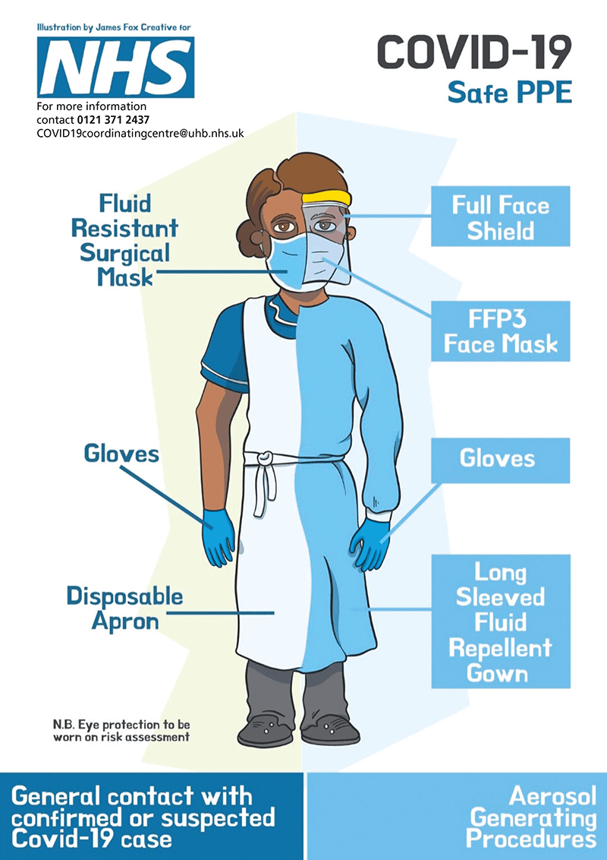
Your employer has been advised to protect staff with this PPE

Slide 14
The following link is a PHE chart recommending personal protective equipment for settings including Social Care
https://assets.publishing.service.gov.uk/government/uploads/system/uploads/attachment_data/file/878750/T2_poster_Recommended_PPE_for_primary__outpatient__community_and_social_care_by_setting.pdf
PHE have also published this guide ‘How to Work Safely in Care Homes’ https://assets.publishing.service.gov.uk/government/uploads/system/uploads/attachment_data/file/881329/COVID-19_How_to_work_safely_in_care_homes.pdf
The following slides highlight some key issues from this guide
Always read the actual guide for full details
Discuss with your manager about wearing PPE and be informed by risk assessment in your care home

Slide 15
Situation 1
Providing personal care requiring you to be in direct contact with residents(s) (e.g. touching)
OR
within two meters of resident who is coughing

Slide 16
Situation 2
Performing a task requiring you to be within 2 meters of resident(s) but no direct contact with resident(s) (i.e. no touching)
e.g. cleaning close to resident(s)

Slide 17
Situation 3
Working in communal areas with residents – no direct contact with resident(s) though potentially within 2 meters
e.g. working in dining rooms, lounges, corridors etc.
The following slides look at the PPE recommended in these 3 situations

Slide 18
Situation 1 Providing personal care requiring you to be in direct contact with residents(s) (e.g. touching) OR within two meters of resident who is coughing
Disposable gloves (single use)
Disposable plastic apron (single use)
Fluid resistant surgical mask (can be used continually while caring until you take a break from duties)
Eye protection (where risk of droplets or secretions from residents mouth, nose, or bodily fluids – e.g. coughing or vomiting

Slide 19
Situation 2 Performing a task requiring you to be within 2 meters of resident(s) but no direct contact with resident(s) (i.e. no touching)
Surgical mask
Eye protection (where risk of droplets or secretions from residents mouth, nose, or bodily fluids – e.g. coughing or vomiting)

Slide 20
Situation 3 Working in communal areas with resident(s)-no direct contact though potentially within 2 meters
Surgical Mask
(can be used continually while providing care, until you take a break from duties – mask does not need to be fluid repellent unless your already wearing one)

Slide 21
Caring in peoples homes
Personal protective equipment (PPE) – resource for care workers delivering homecare (domiciliary care) during sustained COVID-19 transmission in England here:
https://assets.publishing.service.gov.uk/government/uploads/system/uploads/attachment_data/file/884165/Domiciliary_guidance_England.pdf
How to work safely in domiciliary care in England here:
https://www.gov.uk/government/publications/covid-19-how-to-work-safely-in-domiciliary-care

Slide 22
Key points from links on previous slides – always read the full guidance
Individuals home or usual place of residence
Situation 1
Direct care to any member of a household where one or more is a possible or confirmed case:
PPE = Plastic apron, Fluid Repellent Surgical Mask, Eye protection and Gloves recommended

Slide 23
Situation 2
Care to any individual meeting criteria for shielding (vulnerable groups) or anyone else shielding in the household) - definition below
criteria for shielding (vulnerable groups)
Minimum PPE = Single use disposable apron, surgical mask and gloves – must be worn for protection of the patient

Slide 24
The above also applies to:
Community and social care settings
Care homes
Mental health inpatients
Learning disability and autism residential units
Hospices
Prisons
Other overnight care units
Note: In these settings, the need for eye protection is subject to risk assessment meaning dependent on whether the nature of care and whether the individual symptoms present risk of droplet transmission

Slide 25
Information to be provided
Key Protection
information
Needs to be understand-able
Safety reps entitled to see all relevant documents
What the risks and dangers are or could be
What is done or will be done to reduce or stop the risks and dangers
What they ought to do when faced with a risk or dangerous occurence
The identity of a Competent Person

Slide 26
Consultation
Key Protection
‘All employers must inform and consult their employees on health and safety issues’
‘Employers have a responsibility to provide information to all workers that will enable them to know the risks and allow them to participate fully and effectively in consultations about their health and safety’
Health and Safety Executive

Slide 27
Health and Safety Legislation
Key Protection
Adhere to all health and safety law and guidance
Health and Safety at work Act
PPE Regulations
RIDDOR
Health and Safety at Work Regulations 1999

Slide 28
Reporting of Injuries, Diseases and Dangerous Occurrences Regulations 2013 (RIDDOR 2013)
Requires employers to report and keep records of:
Work related deaths
Accidents resulting in serious injury
Diagnosed industrial diseases
Dangerous occurrences with potential for harm
Serious harm or death caused by Covid-19 is reportable under RIDDOR.

Slide 29
Health and Safety Advice, Guidance, Directives and Enforcement for Health Employees
 | Public Health England | Public Health Wales | Health Protection Scotland | Health Protection Service Northern Ireland | Health and Safety Executive (HSE) | Care Quality Commission | Advisory, Conciliation and Arbitration Services (ACAS)
Directives | √ | √ | √ | √ | √ | √
Advice | √ | √ | √ | √ | √ | √ | √
Guidance | √ | √ | √ | √ | √ | √ | √
Legal Enforcement |  |  |  |  | √ | √

Slide 30
Feeling unsafe at work?
If you are worried that your employer is not properly assessing the risks and taking steps to protect you at work, you should contact your UNISON health and safety rep. You can do this via your UNISON branch. If you don’t know how to contact your branch use our branch contact finder at
https://branches.unison.org.uk/
Information on your rights at work
https://www.unison.org.uk/coronavirus-rights-work/

Slide 31
Feeling Unsafe? - Some escalation steps
Talk to managers
2 Put concerns in writing, document the hazards and measures needed to minimise the risk and record when a timed response is expected.
3 Report to your rep/branch and/or Regional Organiser and ask for advice
4 If working for a contractor ask branch to complain to contracting authority
If you are a Health and Safety rep carry out a workplace inspection either jointly or unilaterally using your rights as a H&S rep. Repeat advice under ‘2’. (if not a H&S rep consider becoming one)
Raise matter with your joint health and safety committee
If after taking all reasonable steps consider contacting the HSE (Using contact point Union.Covidconcerns@hse.gov.uk
You should let them know your concerns, danger(s) to safety, measures needed, and the steps you taken to reach agreement with your employer

Slide 32
What if I don’t feel my workplace is safe?
UNISON believes that our members should never be in a situation where they might endanger themselves and others in the course of doing jobs.
Putting you in that situation is potentially a breach of health and safety law and may spread coronavirus to people in high-risk groups.

Slide 33
What if I don’t feel my workplace is safe?
As a last resort, when faced with a dangerous working environment which cannot reasonably be averted, every employee has the right not to suffer detriment if they leave, or refuse to attend their place of work (or take other appropriate steps) in circumstances where they reasonably believe there is a risk of being exposed to serious and imminent danger (section 44 of the Employment Rights Act 1996).

Slide 34
What if I don’t feel my workplace is safe?
Although this is very much a right of last resort, the context of a situation will be key on whether refusing to return to work or any other steps are appropriate. This means that an employee cannot automatically refuse a reasonable instruction to return to work without a good reason.
If you feel you are being put at risk it is crucial to get advice and discuss the situation with your UNISON representative. Contact your branch and if needed you can seek advice from our regional office or legal team.

Slide 35
Useful Links 1
Contact Public Health England here:
Contacts: PHE regions and local centres - GOV.UK
Health Protection Scotland here:
HPS Website - Contact Us - Health Protection Scotland
Public Health Wales here:
Contact Us - Public Health Wales
Public Health Agency Northern Ireland here:
Public Health Agency | nidirect

Slide 36
Useful links 2
More information from Public Health England here:
https://www.gov.uk/government/publications/wuhan-novel-coronavirus-infection-prevention-and-control/covid-19-personal-protective-equipment-ppe
More information from Health Protection Scotland here:
https://www.hps.scot.nhs.uk/a-to-z-of-topics/wuhan-novel-coronavirus/
More Information from Public Health Wales here:
https://gov.wales/coronavirus-covid-19-guidance-social-or-community-care-and-residential-settings
https://phw.nhs.wales/topics/latest-information-on-novel-coronavirus-covid-19/
More information from Public Health Agency Northern Ireland.
https://www.gov.uk/government/publications/wuhan-novel-coronavirus-infection-prevention-and-control
https://www.unison-ni.org.uk/sites/default/files/HSC Coronavirus New_0.pdf

Slide 37
Useful Links 3
Personal protective equipment (PPE) – resource for care workers delivering homecare (domiciliary care) during sustained COVID-19 transmission in England here:
https://assets.publishing.service.gov.uk/government/uploads/system/uploads/attachment_data/file/884165/Domiciliary_guidance_England.pdf
How to work safely in domiciliary care in England here:
https://www.gov.uk/government/publications/covid-19-how-to-work-safely-in-domiciliary-care
Heath and Safety Executive contact point
Union.Covidconcerns@hse.gov.uk
Criteria for shielding (vulnerable groups):
criteria for shielding (vulnerable groups)

Slide 38
Useful Links 4
Main COVID-19 advice page
https://www.unison.org.uk/coronavirus-rights-work/
Main PPE Guidance
https://www.unison.org.uk/coronavirus-rights-work/personal-protective-equipment-coronavirus/
Existing COVID-19 Bargaining Guides
https://www.unison.org.uk/get-involved/in-your-workplace/key-documents-tools-activists/bargaining-guides/
Outside UNISON
Public Health Advice Page central hub for PPE
https://www.gov.uk/government/publications/wuhan-novel-coronavirus-infection-prevention-and-control?utm_source=7c916e5e-b965-44d0-a304-cf38d248abba&utm_medium=email&utm_campaign=govuk-notifications&utm_content=immediate
HSE sources
https://www.hse.gov.uk/news/coronavirus.htm

